Slide 1
Flight Price Prediction
By Satu Pole
Intern- Flip Robo Technologies

Slide 2
Contents
Problem statement
Flight price prediction?
Introduction to dataset
Treating Null values, duplicates and data cleaning
Visualization
Dropping non related columns
Treating outliers, skewness and using encodding and VIF
Plots used for visualization
Algorithms used
Model performance
Key metrics used to understand model
Conclusion

Slide 3
Problem Statement
Flights are one of the 3 modes of transport used frequently by person to travel around the world. There are various websites that are used to book flight tickets. It is often seen flight prices mostly increases as the booking date comes nearer, and in some instances during holiday seasons the flight prices are higher compared to other days.
Hence a model needs to be made that will both help customer in getting flight prices cheaper and also benefitting flights such as early prediction of the demand along a given route could help an airline company pre-plan the flights and determine appropriate pricing for the route.

Slide 4
What is Flight Price Prediction?
Flight price prediction is a way of predicting flight ticket prices using machine learning models. This will help persons travelling to book/plan their journey based on the flight prices.
This will also benefit flight companies to know the influx of customers booking flight tickets and increase or decrease price and earn more profit. In this way if customers are more in certain route they can pre-plan flights accordingly.

Slide 5
Exploratory Data Analysis- Introduction to dataset
The data which was later transformed into csv file was scrapped from kayak.in website. The scrapped data included columns such as Date, flight name, arrival and departure locations and timings, flight duration, stops taken by flight,data source and flight prices. The flight locations were fixed i.e flight departing from Goa Airport and arriving at Delhi Airport.
The dataset had dates from 26th Jan (thursday) to 1st Feb 2023 (wednesday) i.e. 1 week data.
The target variable was price so it was know that it is going to be a regression kind of problem.
The dataset shape was 2117 rows and 12 columns. Later it came to 10 columns as 2 unwanted columns named ‘Unnamed 0’ and ‘0.1’ were dropped.

Slide 6
Exploratory Data Analysis- Treating duplicates, Null values and Data cleaning
The dataset was checked for duplicates and it was found that it had 64 duplicate entries which were later removed.
There were no null values present in dataset.
The column duration had data in form of ‘2h20m’. Using python code the h and m were removed and data was appended into 2 seperate columns.
similarly the arrival time column had ‘+1’ added to time, hence it was removed using .replace method

Slide 7
Exploratory Data Analysis- Treating duplicates, Null values and Data cleaning contd.
Further the price column had rupee symbol present. This was removed using .replace method and rupee symbol was replaced with empty spaces.

Slide 8
Exploratory Data Analysis- Visualization
Univariate, Bivariate and Multivariate analysis was done to visualize the data and to understand it.
It was known from visualization that Air India and Vistara operates most flight for this particular destinations.
It was known that Qatar Airways is the expensive flight to travel while AirAsia and Indigo are cheaper alternatives.
It was known that most flights took one stop and very less flights took >2 stops to reach destination
It was known that prices started increasing as the weekend came closer and then prices started dropping.

Slide 9
Exploratory Data Analysis- Visualization contd.
Also flight departing at post lunch and at midnight to 2 am were priced higher compared to other timings.
As the number of stops increases, the flight prices for that particular flight increases.
There were no multicollinearity seen within features, target variable being price.

Slide 10
Dropping non related columns
The duration data was divided into 2 columns as hours and minutes.
Similarly arrival time departure time columns were divided as hour and minutes and the original columns were dropped from dataset.
Also since there was only 1 departure and arrival location, both these columns were dropped as this columns are not good for model building.

Slide 11
Treating Outliers and Skewness and Encoding
The object datatype columns were encoded using Label Encoder
The dataset was checked for outliers using boxplots and it was found that only duration hours column had outliers present. These were later removed using z-score method.
There was no presence of skewness in dataset.

Slide 12
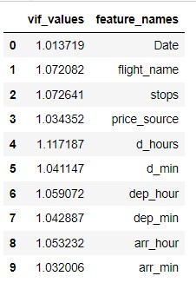
VIF to check for multicollinearity
It can be seen from the table that, no multicollinearity was seen within features.

Slide 13
Types of plots that were used in analysis
Countplot (univariate analysis for categorical data)
Swarmplot ( univariate analysis for continuous data)
Heatmap (multivariate analysis showing correlation within features)
Barplot (quantitative relationship of label with feature)
boxplot (to check for outliers in dataset)
distplot (to check for skewness in dataset)

Slide 14
Algorithms used for model making
Random Forest Regressor model.
AdaBoost Regressor model.
Decision Tree Regressor model.
Gradient Boosting Regressor model.
The best model chosen for hyperparameter tuning was Random Forest model as it had better R2 testing accuracy then other models and its RMSE value was low compared to other models.

Slide 15
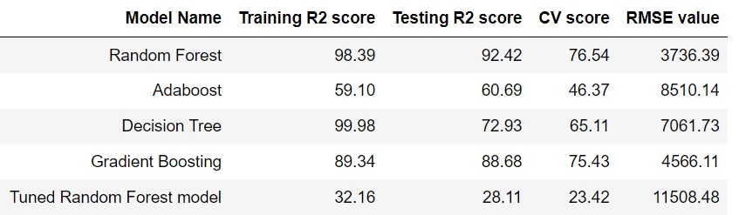
Model performance
The table shows regression models training and testing R2 score alongwith metrics used to identify best model.
The table also shows the data of tuned model whose R2 scores are very low compared to original Random Forest model.

Slide 16
Key Metrics Used to Understand Models
I have used the following metrics for evaluation: 
cross validation scores: to predict if the model is overfitted or not. Best fit model will have same or near cross validation score.
Root mean square error(RMSE): is one of the most commonly used measures for evaluating the quality of predictions. Lower the RMSE value better the model.
R2 Score:tells us how accurate our model is. This value is also used as accuracy to claim how good the model is.

Slide 17
Conclusion
➢This dataset contained very less data I.e. nearly 2000 data points. This can be increased by scrapping or getting more data on flights, so model knowledge will increase subsequently it performing well.
➢Also this data is only limited to only 1 departure and arrival. If the data was scrapped for multiple locations then it would have been better analyzing data and learning about how flights work for other locations.
➢In this dataset the only time price is showing variation when the weekend comes nearer. This is because data was limited to only 7 days. Hence we can add data for months to better analyzing it. Also we should also take into account seasonal/ festival holidays as this times flight prices tend to increase.

Slide 18
Conclusion contd.
In this dataset the columns were only 10-12, hence analysing was not upto mark. This additional day may include columns like flight route, kind of food served in flights, leg room provided or not, window and aisle seating, etc as this will help customers to book their flights based on the services they are being offered. This data can also be used by flight companies to see what kind of services are actually required by customers and customize their flight experiences as per customers needs resulting in higher customer influx in turn good profits.

Slide 19
Thank You!!

